Slide 1
Modern L3 Networks

Slide 2
Classless InterDomain Routing (CIDR)
“Dynamic” subnetting which allows for a variable number of bits to be used as the subnet mask for a given IP
Also known as Variable Length Subnet Mask (VLSM)
Allows for a more efficient use of network addresses, since we can carve out only the number of bits for the host portion of the our IP that we need to address all the hosts on that subnet (plus some extra for growth)

Slide 3
Important CIDR Information
For CIDR IP addresses, we need to be able to calculate/determine the following pieces of information
Network ID/Network Address
Broadcast Address
Start Address
End Address
Number of Hosts
Number of Networks
These are static in classful routing, but will vary with CIDR

Slide 4
CIDR Notation
Classful Subnets
X.X.X.X/8
X.X.X.X/16
X.X.X.X/24
CIDR Subnets
X.X.X.X/[1-32]
192.56.34.87/13
10.33.42.132/29

Slide 5
CIDR Network Address
187.13.56.7/13
IP Address
1 | 0 | 1 | 1 | 1 | 0 | 1 | 1 | . | 0 | 0 | 0 | 0 | 1 | 1 | 0 | 1 | . | 0 | 0 | 1 | 1 | 1 | 0 | 0 | 0 | . | 0 | 0 | 0 | 0 | 0 | 1 | 1 | 1
255.248.0.0
Subnet Mask
1 | 1 | 1 | 1 | 1 | 1 | 1 | 1 | . | 1 | 1 | 1 | 1 | 1 | 0 | 0 | 0 | . | 0 | 0 | 0 | 0 | 0 | 0 | 0 | 0 | . | 0 | 0 | 0 | 0 | 0 | 0 | 0 | 0
187.8.0.0
Network ID = IP & Subnet Mask
1 | 0 | 1 | 1 | 1 | 0 | 1 | 1 | . | 0 | 0 | 0 | 0 | 1 | 0 | 0 | 0 | . | 0 | 0 | 0 | 0 | 0 | 0 | 0 | 0 | . | 0 | 0 | 0 | 0 | 0 | 0 | 0 | 0

Slide 6
CIDR Broadcast Address
187.13.56.7/13
IP Address
1 | 0 | 1 | 1 | 1 | 0 | 1 | 1 | . | 0 | 0 | 0 | 0 | 1 | 1 | 0 | 1 | . | 0 | 0 | 1 | 1 | 1 | 0 | 0 | 0 | . | 0 | 0 | 0 | 0 | 0 | 1 | 1 | 1
255.248.0.0
Subnet Mask
1 | 1 | 1 | 1 | 1 | 1 | 1 | 1 | . | 1 | 1 | 1 | 1 | 1 | 0 | 0 | 0 | . | 0 | 0 | 0 | 0 | 0 | 0 | 0 | 0 | . | 0 | 0 | 0 | 0 | 0 | 0 | 0 | 0
!255.248.0.0 = 0.7.255.255
0 | 0 | 0 | 0 | 0 | 0 | 0 | 0 | . | 0 | 0 | 0 | 0 | 0 | 1 | 1 | 1 | . | 1 | 1 | 1 | 1 | 1 | 1 | 1 | 1 | . | 1 | 1 | 1 | 1 | 1 | 1 | 1 | 1
187.15.255.255
Broadcast Address = IP | !Subnet Mask
1 | 0 | 1 | 1 | 1 | 0 | 1 | 1 | . | 0 | 0 | 0 | 0 | 1 | 1 | 1 | 1 | . | 1 | 1 | 1 | 1 | 1 | 1 | 1 | 1 | . | 1 | 1 | 1 | 1 | 1 | 1 | 1 | 1

Slide 7
CIDR Hosts & Subnets
CIDR notation tells you how many bits are used for subnet addressing
Number of subnets is 2^{(subnet bits)}
For 13 bits 2¹³ = 8,192
Since we know the bits of the subnet, the rest are used for host addressing
Number of hosts is 2^{(32 - subnet bits)} - 2
For 13 bits 2⁽³²⁻¹³⁾ - 2 = 524,286
Why do we subtract 2 from the number of hosts but not the number of subnets?
Notes:
We subtract 2 from the number of hosts to account for the network address and the broadcast address, which aren’t actually addressable

Slide 8
CIDR First & Last Address
187.13.56.7/13
Subnet Mask: 255.248.0.0
Network Address: 187.8.0.0
Broadcast Address: 187.15.255.255
First Address: 187.8.0.1 (Network Address + 1)
Last Address: 187.15.255.254 (Broadcast Address - 1)
Number of Hosts: 2⁽³²⁻¹³⁾ - 2 = 524,286
Number of Subnets: 2¹³ = 8,192
Usable Address Range: 187.8.0.1 - 187.15.255.254

Slide 9
CIDR Network Address
255.71.228.14/21
IP Address
1 | 1 | 1 | 0 | 0 | 0 | 0 | 1 | . | 0 | 1 | 0 | 0 | 0 | 1 | 1 | 1 | . | 1 | 1 | 1 | 0 | 0 | 1 | 0 | 0 | . | 0 | 0 | 0 | 0 | 1 | 1 | 1 | 0
255.255.248.0
Subnet Mask
1 | 1 | 1 | 1 | 1 | 1 | 1 | 1 | . | 1 | 1 | 1 | 1 | 1 | 1 | 1 | 1 | . | 1 | 1 | 1 | 1 | 1 | 0 | 0 | 0 | . | 0 | 0 | 0 | 0 | 0 | 0 | 0 | 0
255.71.224.0
Network ID = IP & Subnet Mask
1 | 1 | 1 | 0 | 0 | 0 | 0 | 1 | . | 0 | 1 | 0 | 0 | 0 | 1 | 1 | 1 | . | 1 | 1 | 1 | 0 | 0 | 0 | 0 | 0 | . | 0 | 0 | 0 | 0 | 0 | 0 | 0 | 0

Slide 10
CIDR Broadcast Address
255.71.228.14/21
IP Address
1 | 1 | 1 | 0 | 0 | 0 | 0 | 1 | . | 0 | 1 | 0 | 0 | 0 | 1 | 1 | 1 | . | 1 | 1 | 1 | 0 | 0 | 1 | 0 | 0 | . | 0 | 0 | 0 | 0 | 1 | 1 | 1 | 0
255.255.248.0
Subnet Mask
1 | 1 | 1 | 1 | 1 | 1 | 1 | 1 | . | 1 | 1 | 1 | 1 | 1 | 1 | 1 | 1 | . | 1 | 1 | 1 | 1 | 1 | 0 | 0 | 0 | . | 0 | 0 | 0 | 0 | 0 | 0 | 0 | 0
!255.255.248.0 = 0.0.1.255
0 | 0 | 0 | 0 | 0 | 0 | 0 | 0 | . | 0 | 0 | 0 | 0 | 0 | 0 | 0 | 0 | . | 0 | 0 | 0 | 0 | 0 | 1 | 1 | 1 | . | 1 | 1 | 1 | 1 | 1 | 1 | 1 | 1
255.71.231.255
Broadcast Address = IP | !Subnet Mask
1 | 1 | 1 | 0 | 0 | 0 | 0 | 1 | . | 0 | 1 | 0 | 0 | 0 | 1 | 1 | 1 | . | 1 | 1 | 1 | 0 | 0 | 1 | 1 | 1 | . | 1 | 1 | 1 | 1 | 1 | 1 | 1 | 1

Slide 11
CIDR First & Last Address
255.71.228.14/21
Subnet Mask: 255.255.248.0
Network Address: 255.71.224.0
Broadcast Address: 255.71.231.255
First Address: 255.71.224.1 (Network Address + 1)
Last Address: 255.71.231.254 (Broadcast Address - 1)
Number of Hosts: 2⁽³²⁻²¹⁾ - 2 = 2,046
Number of Subnets: 2²¹ = 2,097,152
Usable Address Range: 255.71.224.1 - 255.71.231.254

Slide 12
CIDR Address Information (Exercise)
Calculate the following information for the given CIDR IP addresses
Subnet Mask
Network Address
Broadcast Address
First Address
Last Address
Number of Hosts
Number of Subnets
Usable Address Range
IP Addresses: 192.168.0.1/14, 10.25.17.4/20, 172.195.67.12/10
Notes:
192.168.0.1/14 -> 11000000.10101000.00000000.00000001
Subnet Mask: 11111111.11111100.00000000.00000000 = !00000000.00000011.11111111.11111111
Network Address: 11000000.10101000.00000000.00000000 = 192.168.0.0
Broadcast Address: 11000000.10101011.11111111.11111111 = 192.171.255.255
First Address: 11000000.10101000.00000000.00000001 = 192.168.0.1
Last Address: 11000000.10101011.11111111.11111110 = 192.171.255.254
Number of Hosts: 2^(32-14) - 2 = 262142
Number of Subnets: 2^14 = 16384
Usable Address Range: 192.168.0.1 - 192.171.255.254
10.25.16.4/20 -> 00001010.00011001.00010001.00000100
Subnet Mask: 11111111.11111111.11110000.0000 = !00000000.00000000.00001111.11111111
Network Address: 00001010.00011001.00010000.00000000 = 10.25.16.0
Broadcast Address: 00001010.00011001.00011111.11111111 = 10.25.31.255
First Address: 00001010.00011001.00010000.00000001 = 10.25.16.1
Last Address: 00001010.00011001.00011111.11111110 = 10.25.31.254
Number of Hosts: 2^(32-20) - 2 = 4094
Number of Subnets 2^(20) = 1048576
Usable Address Range: 10.25.16.1 - 10.25.31.254
172.195.67.12/10 -> 10101100.11000011.01000011.00001100
Subnet Mask: 11111111.11000000.00000000.00000000 = !00000000.00111111.11111111.11111111
Network Address: 10101100.11000000.00000000.00000000 = 172.192.0.0
Broadcast Address: 10101100.11111111.11111111.11111111 = 172.255.255.255
First Address: 10101100.11000000.00000000.00000001 = 172.192.0.1
Last Address: 10101100.11111111.11111111.11111110 = 172.255.255.254
Number of Hosts: 2^(32-10) - 2: 4194302
Number of Subnets: 2^(10) = 1024
Usable Address Range: 172.192.0.1 - 172.255.255.254

Slide 13
Open Shortest Path First (OSPF)
Most popular dynamic routing protocol, only usable on internal private networks, analogous to STP in L2
Designed for networks using variable length CIDR addresses
It is able to converge on a loop-free topology quickly (seconds)
Can handle any topology structure and allows for authentication
Notes:
Spanning Tree Protocol (STP)

Slide 14
Terminology
Area: way to segment networks in OSPF using a 32 bit ID
Neighbor: connected router running OSPF in the same area
Adjacency Database: table of all OSPF connections that are neighbors
Router ID: unique ID of a router within an area
(Backup) Designated Router: routers which hold global topology view (all routers must form an adjacency to these), they are elected by priority

Slide 15
OSPF Algorithm
Neighbor Discovery:
Use L2 broadcast “hello” messages to identify “adjacent” neighbors
These routers must interface on the same subnet, have different IDs, be in the same area, and have the same authentication parameters
Topology Database Exchange:
Send Link State Advertisements (LSA) onto the network which contains a router ID, list of router interfaces, and list of neighbors on each interface
Routers store this information into the Link State Database (LSDB), which should be the same for all routers in the area
Route Computation
Use a Shortest Path First (SPF) algorithm (equivalent to Dijkstra’s) based on LSDB information
Update the routing table with the routes calculated using SPF

Slide 16
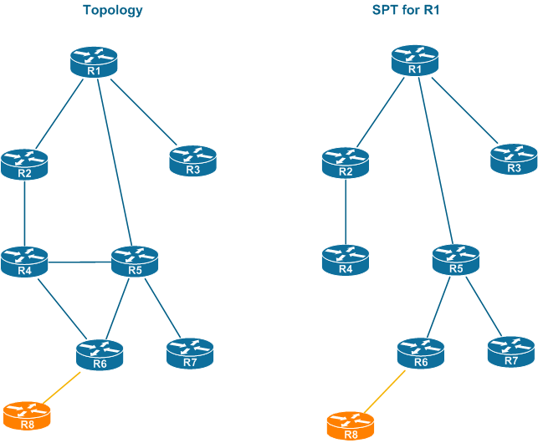
Notes:
Shortest Path Tree (SPT) is the resulting tree from running SPF

Slide 17
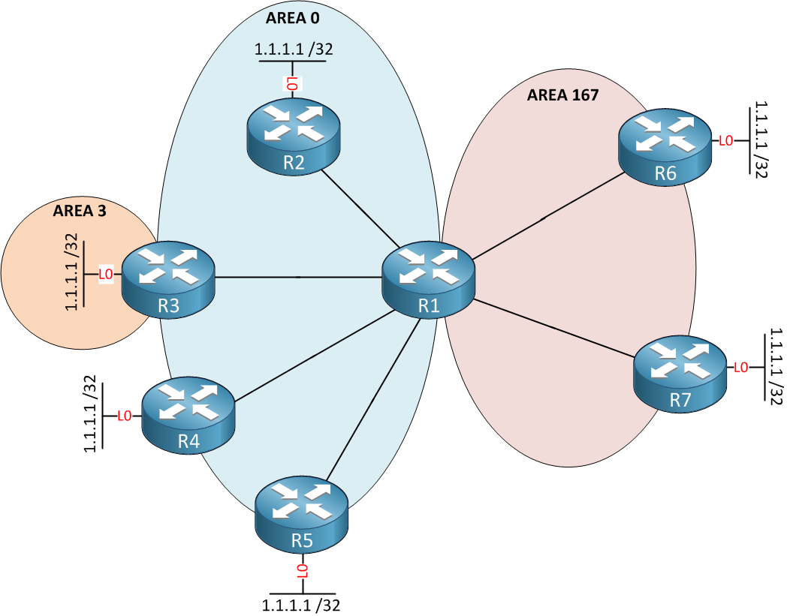
Areas
Breaking our network into smaller areas allow for a number of benefits when running OSPF
Smaller LSDBs for each router in the area
Reduction in the amount of LSA traffic, since it won’t traverse area boundaries
Quicker SPF calculations (mostly because of the above)

Slide 18
L3 ACLs and Firewalls
While ACLs and Firewalls can be deployed on L2, 3, and 4 they are most often utilized in L3 (IP traffic) and L4/7 (Port traffic) to perform either packet blocking/shaping or “application” blocking/shaping.
ACL rules can be based on source address, destination address, and port (although technically this is an L4/7 ACL, most routers can use this info)
Incoming packets are compared to ACL entries based on the order that the entries occur in the router they are passing through
If the packet does not match an Access Control Entry (ACE), the packet is then matched against the next ACE in the list
If a packet and an access list statement match, the rest of the statements in the list are skipped
If no conditions match an ACE, the packet is dropped
Notes:
Note that the above ACL handling of L3 packets is based on the defaults for the Cisco ASR 900 series router.

Slide 19
Questions?

Slide 20
Additional
CIDR Supernet Calculator
Binary to IP Converter, IP to Binary Converter
Know your Firewall: Layer 3 vs Layer 7

